Slide 1
Standing Up for What You Believe in: Renee Gross’s Story

Slide 2
This slideshow tells the story of Renee (“REE-nee”) Gross, who immigrated to the United States as a child and dedicated her life to supporting her community, sharing art, and standing up for justice.

Slide 3
Each slide has an image (or several) and some questions to encourage you to think about Renee and her life.

Slide 4
Look carefully at the images together. Read the questions, share ideas, and make observations.

Slide 5
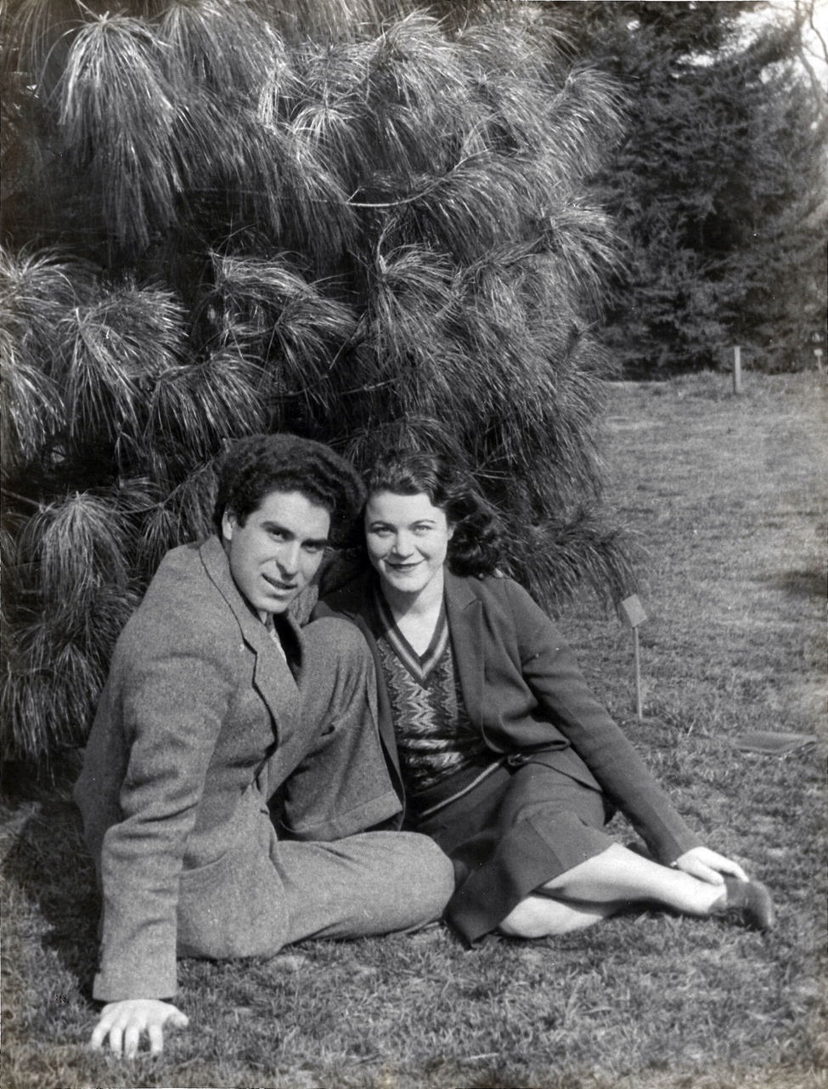
Renee Gross, seen on the left with her husband, Chaim Gross, immigrated from Lithuania to the United States in 1921. Her father arrived first, and was later joined by Renee, her mother, and siblings.
Unknown photographer, Chaim and Renee Gross, c. 1932, photograph

Slide 6
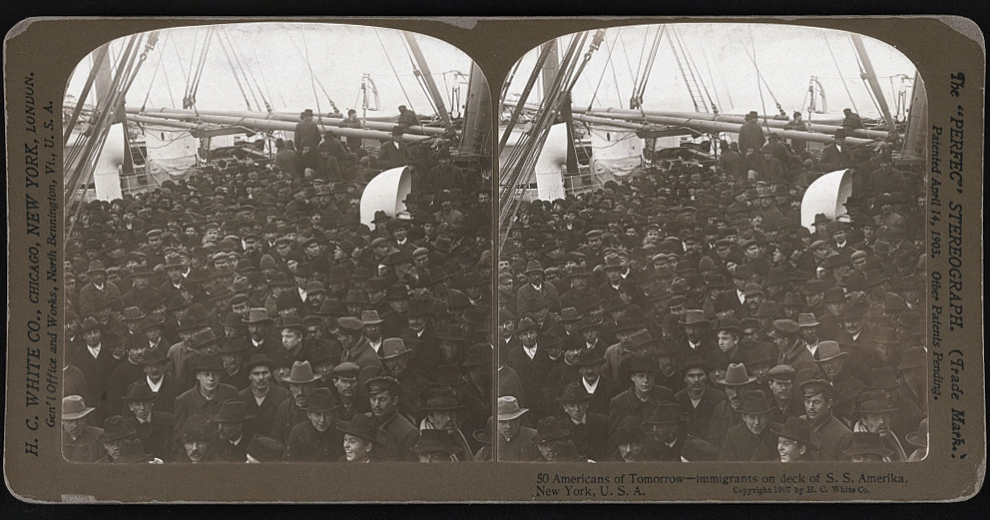
Renee traveled from Poland to Maine on a boat, which was quarantined for a month upon arrival due to an outbreak of illness. The photograph on the right shows immigrants on a ship from around the same time.
H.C. White Co., 50 Americans of tomorrow - immigrants on deck of S.S. Amerika, New York, U.S.A. , 1907, stereograph

Slide 7
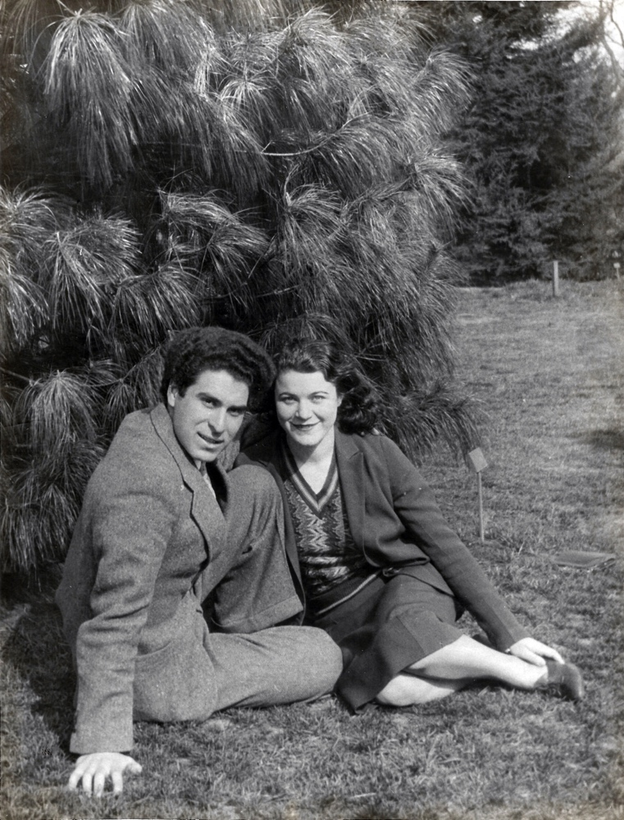
What do you think it would be like to be separated from a parent while your family immigrated to a new country? How do you think it would feel to be quarantined on a ship?
H.C. White Co., 50 Americans of tomorrow - immigrants on deck of S.S. Amerika, New York, U.S.A. , 1907, stereograph
Unknown photographer, Chaim and Renee Gross, c. 1932, photograph

Slide 8
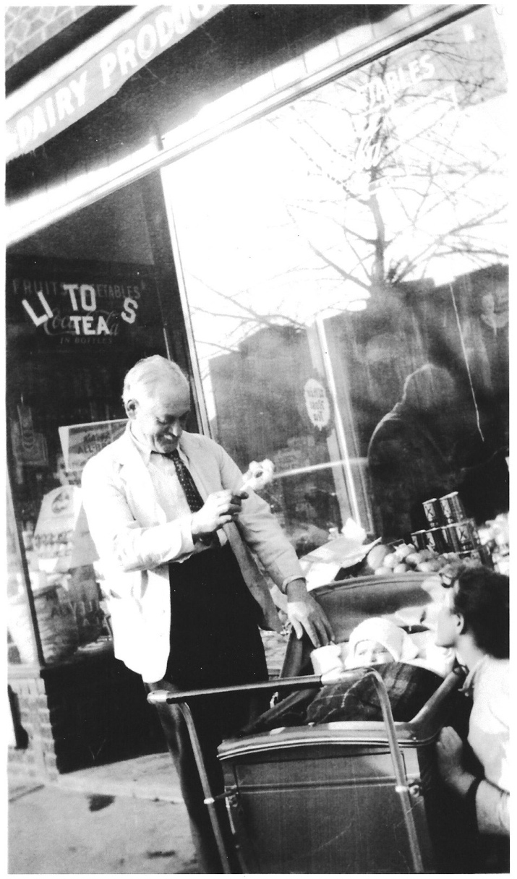
Renee’s family opened a grocery store in Brooklyn. In this photograph, taken in 1935, you can see the store in the background. Her father is looking down at her baby son, Yehudah, and she is next to the carriage.
Unknown photographer, Renee, her father, and her son in front of the family grocery store, c. 1936, photograph

Slide 9
Take a few moments to look carefully at the picture. What details do you notice in the photograph? What do they tell you about this time and place?
Unknown photographer, Renee, her father, and her son in front of the family grocery store, c. 1936, photograph

Slide 10
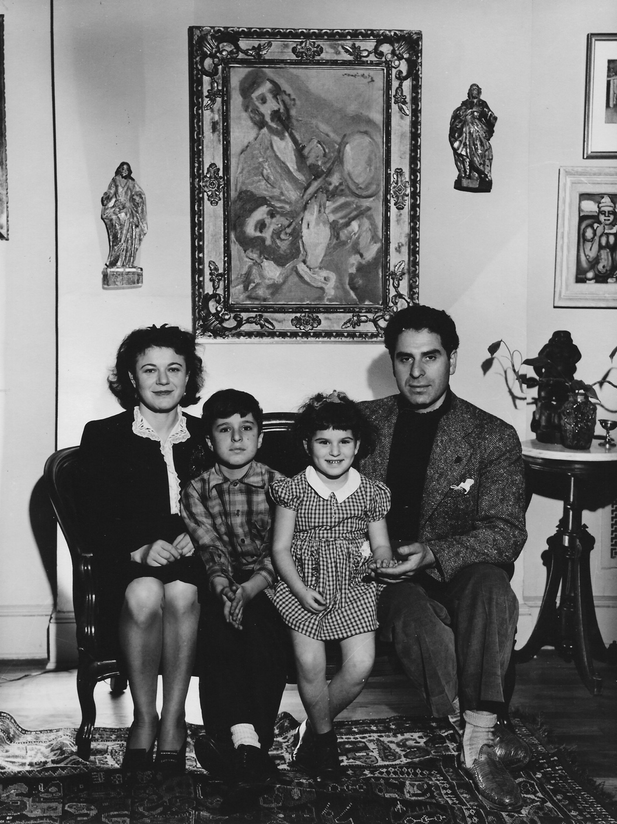
Renee and Chaim had two children, Mimi and Yehudah. This is a family photograph of them from around 1944.
Photograph of the Gross Family, 1944

Slide 11
What catches your eye in the picture? What details do you notice? What might these details tell us about the Gross family?
Photograph of the Gross Family, 1944

Slide 12
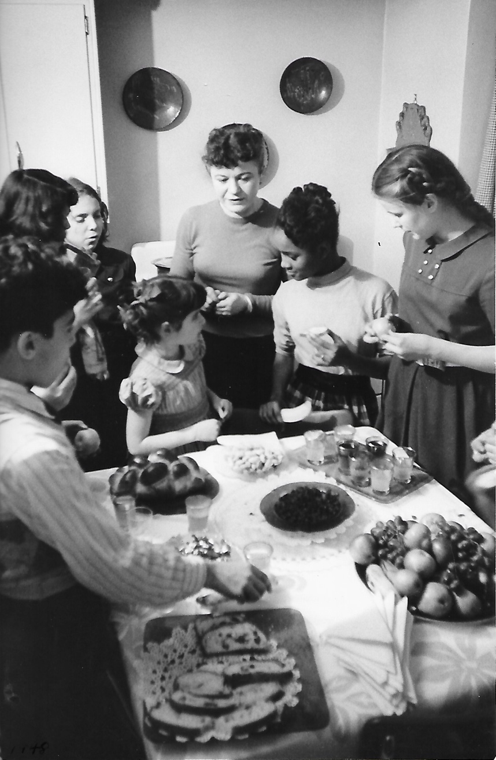
For many years, the family lived in Harlem, a neighborhood in Manhattan. Renee believed in building a sense of community with her friends and neighbors. This photograph shows her hosting a gathering in their home. Take a moment to look closely at it.
Lisa Larsen, Renee Gross with children on the Upper West Side, c. 1946-7, photograph

Slide 13
Why do you think it’s important to feel connected to the people in your community? What do you think is special about sharing food with others? What are some other ways to bring people together?
Lisa Larsen, Renee Gross with children on the Upper West Side, c. 1946-7, photograph

Slide 14
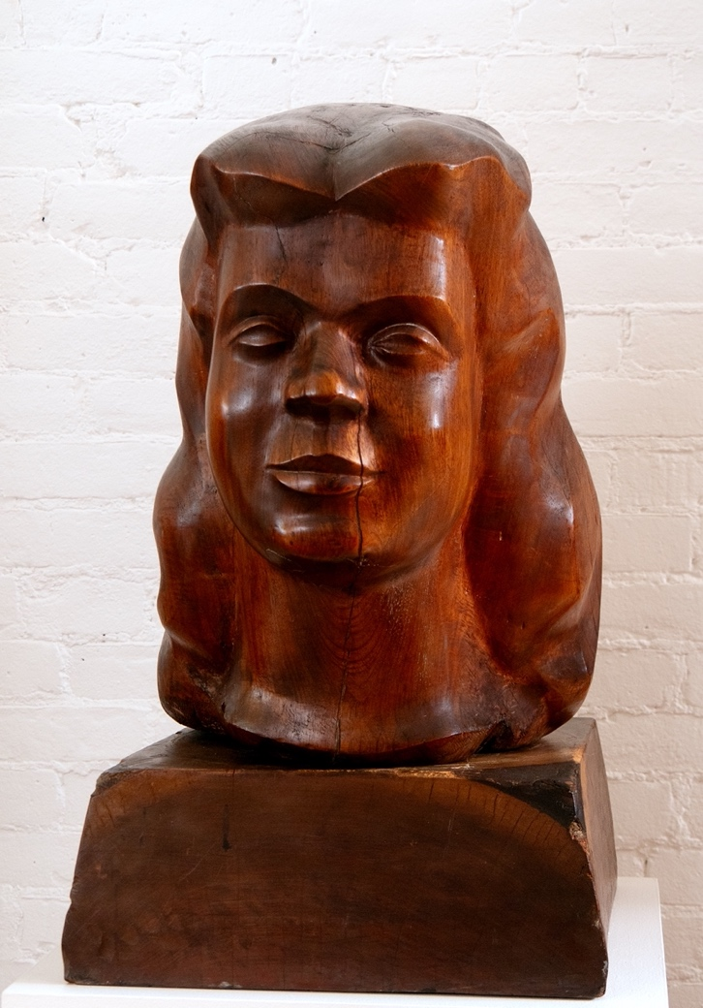
Renee believed that everyone should be treated fairly and equally. She stood up for her beliefs by speaking out, like marching for fair pay for teachers in New York City.
Nicolai Cikovsky, Portrait of Renee, 1932, oil on wood, 12 ½ × 9 inches
Chaim Gross, Head of Renee, 1938, sabicu wood, 19 ¼ × 14 × 19 inches

Slide 15
She and Chaim donated money for scholarships to help students attend college. She raised money to help the country during WWII and to support Jewish people after the war. These two portraits of Renee tell us about what she looked like, but also give us a sense of what kind of person she was.
Nicolai Cikovsky, Portrait of Renee, 1932, oil on wood, 12 ½ × 9 inches
Chaim Gross, Head of Renee, 1938, sabicu wood, 19 ¼ × 14 × 19 inches

Slide 16
The portrait on the left was painted when Renee and Chaim were first starting their life together as a married couple. Chaim made the sculpture on the right six years later, after the birth of their son, and during the Great Depression.
Nicolai Cikovsky, Portrait of Renee, 1932, oil on wood, 12 ½ × 9 inches
Chaim Gross, Head of Renee, 1938, sabicu wood, 19 ¼ × 14 × 19 inches

Slide 17
What do you notice about her facial expression in each portrait? What do you think it would be like to meet her? Who does she remind you of? How so?
Nicolai Cikovsky, Portrait of Renee, 1932, oil on wood, 12 ½ × 9 inches
Chaim Gross, Head of Renee, 1938, sabicu wood, 19 ¼ × 14 × 19 inches

Slide 18
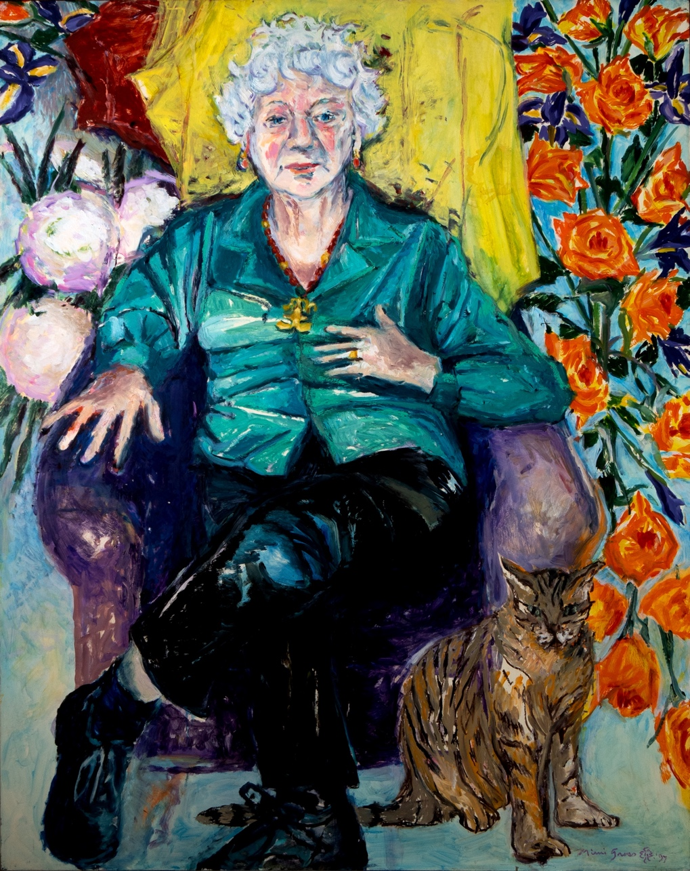
This painting is a portrait of Renee made by her daughter, Mimi Gross. Take a few moments to look carefully at it and notice some interesting details.
Mimi Gross, Portrait of Renee Gross, 1997, acrylic on board, 47 ⅞ × 38 inches

Slide 19
Discuss as a group: What details catch your eye in this painting? What colors and patterns do you notice? What do you think the artist wanted to capture about her mother’s personality? What do you see that makes you say that?
Mimi Gross, Portrait of Renee Gross, 1997, acrylic on board, 47 ⅞ × 38 inches

Slide 20
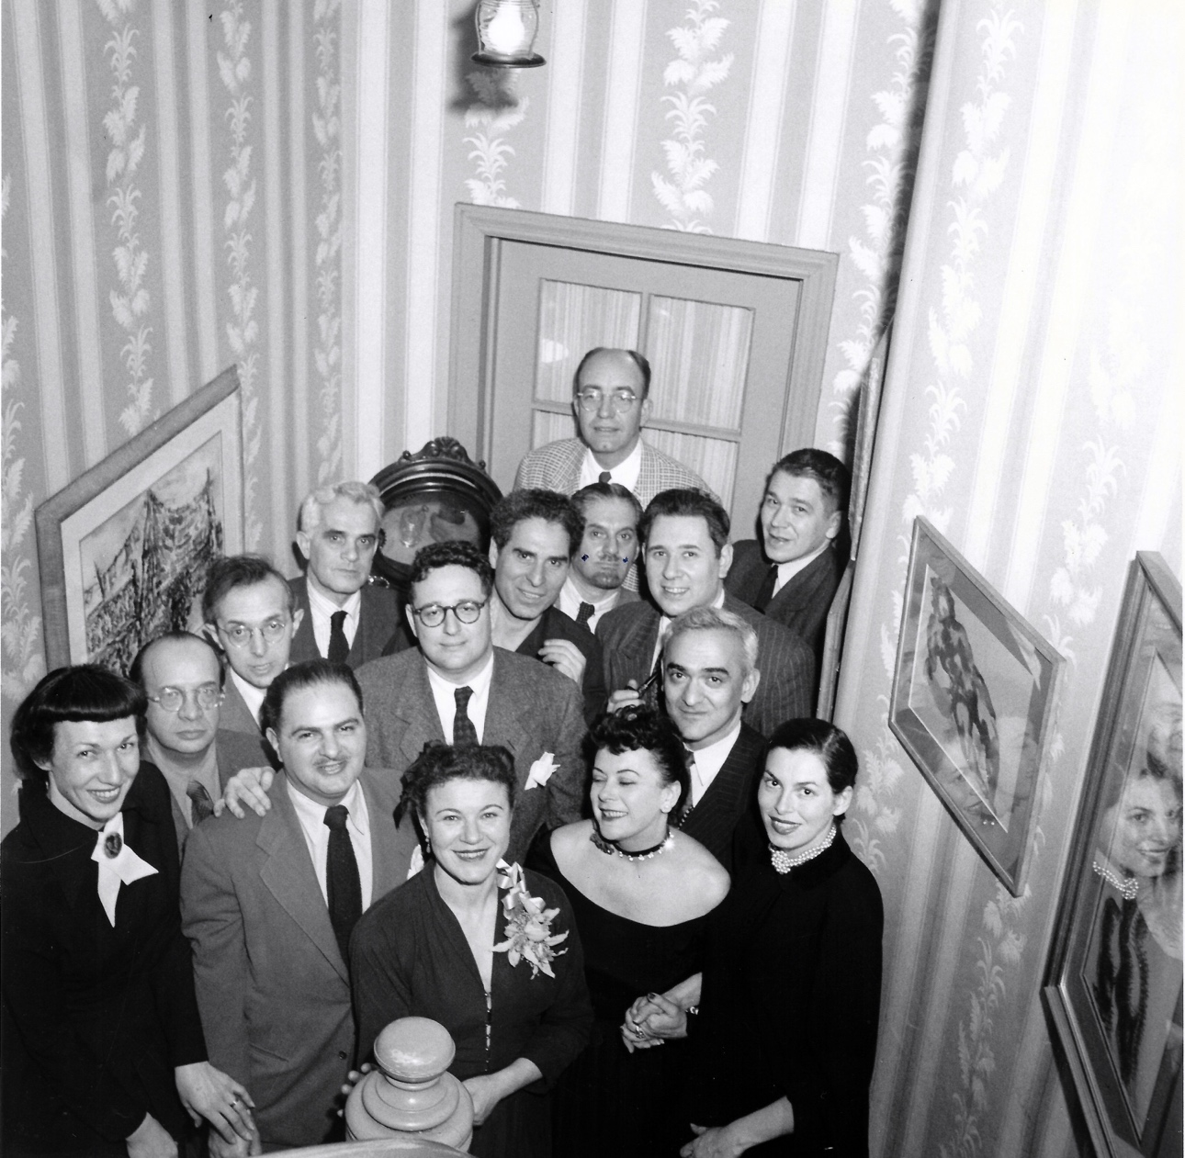
Renee and Chaim often welcomed friends and community members into their home. They created a welcoming environment for people to gather and share ideas.
Photograph of Renee Gross and friends at her home on W. 105th St, New York, c. 1945

Slide 21
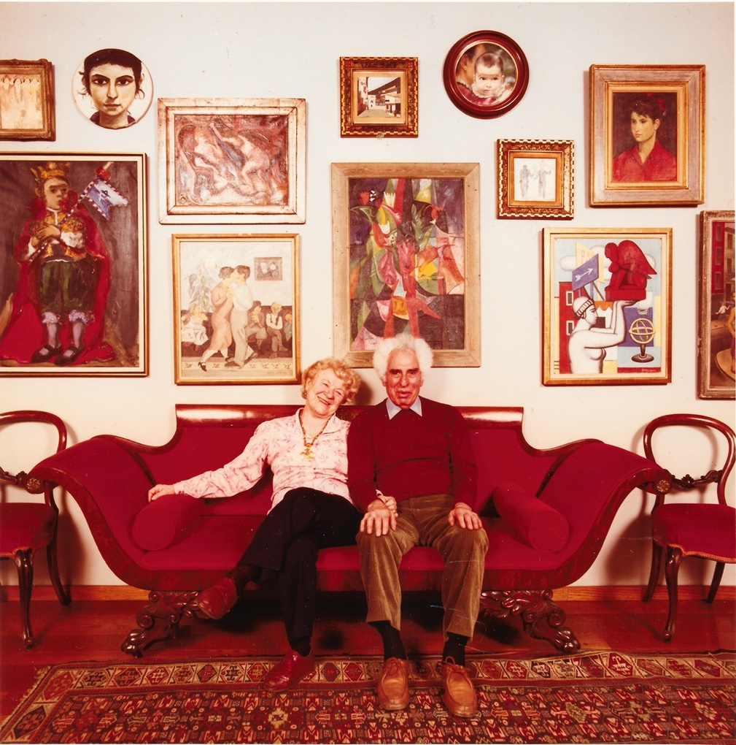
After Chaim died in 1991, Renee opened two floors of their home and studio in Greenwich Village to the public, where people could appreciate their art collection. Today, the Renee and Chaim Gross Foundation remains a unique space where people can experience American art in the context of an artist’s home and studio.
Benno Friedman, Chaim and Renee Gross, c. 1985, photograph

Slide 22
Image Credits
Unknown photographer, Chaim and Renee Gross, c. 1932, photograph. Archives of the Renee & Chaim Gross Foundation, New York.
H.C. White Co., 50 Americans of tomorrow - immigrants on deck of S.S. Amerika, New York, U.S.A., 1907, stereograph. Library of Congress, Prints & Photographs Division, LC-DIG-stereo-1s46127.
Unknown photographer, Renee, her father, and her son in front of the family grocery store, c. 1936, photograph. Archives of the Renee & Chaim Gross Foundation, New York.
Unknown photographer, The Gross Family, 1944, photograph. Archives of the Renee & Chaim Gross Foundation, New York.
Lisa Larsen, Renee Gross with children on the Upper West Side, c. 1946-7, photograph. Life Magazine. Archives of the Renee & Chaim Gross Foundation, New York.
Nicolai Cikovsky, Portrait of Renee, 1932, oil on wood, 12 ½ × 9 inches. Renee & Chaim Gross Foundation, New York.
Chaim Gross, Head of Renee, 1938, sabicu wood, 19 ¼ × 14 × 19 inches. Renee & Chaim Gross Foundation, New York.
Mimi Gross, Portrait of Renee, 1997, acrylic on board, 47 ⅞ × 38 inches. Renee & Chaim Gross Foundation, New York.
Photograph of friends at the Gross family home on W. 105th Street: Hilda Castellón, Sol Wilson, Raphael Soyer, Nicolai Cikovsky, Jack Paser, Arnold Newman, Chaim Gross, Henry Botkin, Alexander Dobkin, Federico Castellón, Hudson D. Walker, Renee Gross, Sylvia Carewe, Augusta Newman, and Isaac Soyer, c. 1945, photograph, 7 ¾ × 7 ¹¹⁄₁₆ inches. Archives of the Renee & Chaim Gross Foundation, New York.
Benno Friedman, Chaim and Renee Gross, c. 1985, photograph. Archives of the Renee & Chaim Gross Foundation, New York.

Slide 23
First established in 1974 with donations from over two dozen close friends and supporters of American artist Chaim Gross (1902-91), the Renee & Chaim Gross Foundation was incorporated as a 501(c)(3) not-for-profit organization in 1989. The Foundation is located in the couple's historic Greenwich Village townhouse and the artist’s studio space at 526 LaGuardia Place.
The Foundation stewards an extensive collection of over 12,000 objects that includes Gross’s sculptures, drawings, and prints; a photographic archive; and their large personal collection of African, Oceanic, Pre-Columbian, American, and European art that remains installed in the townhouse as it was during their lifetimes.
Our mission is to further the legacy of Chaim Gross through high-quality research, exhibitions, and educational activities around our historic building and art collections for audiences in New York City and beyond.
rcgrossfoundation.org
This project is generously supported by a grant from the Dorothy C. Radgowski Learning Through Women’s Achievement in the Arts Grant, a joint effort of Where Women Made History (WWMH), and Historic Artists’ Homes & Studios (HAHS), both programs of the National Trust for Historic Preservation.

